Slide 1
FR3 (6-24 GHz) Software-defined Radio Kit
Contact: founders@pi-rad.io

Slide 2
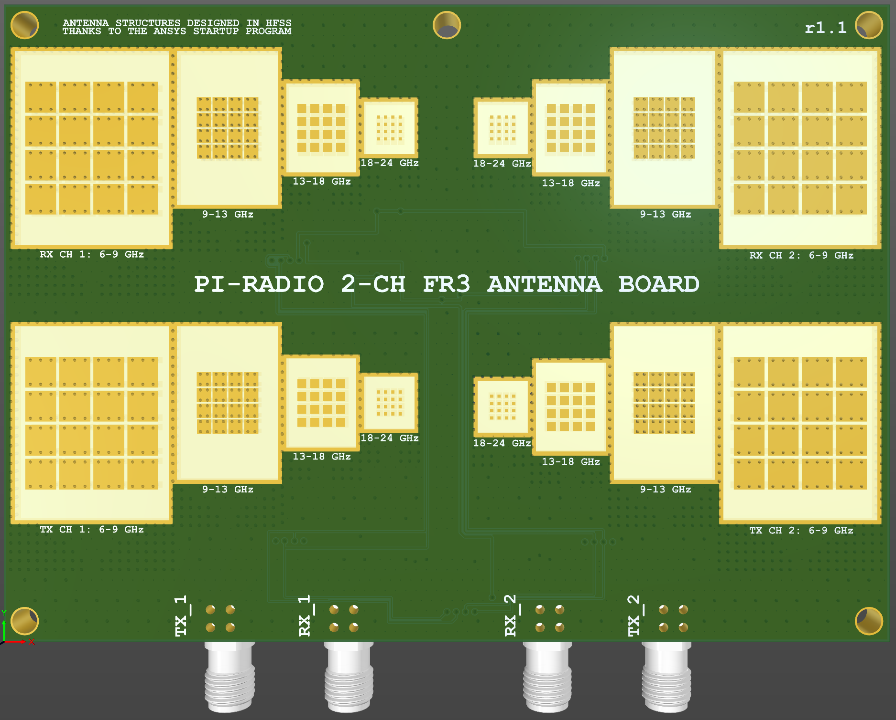
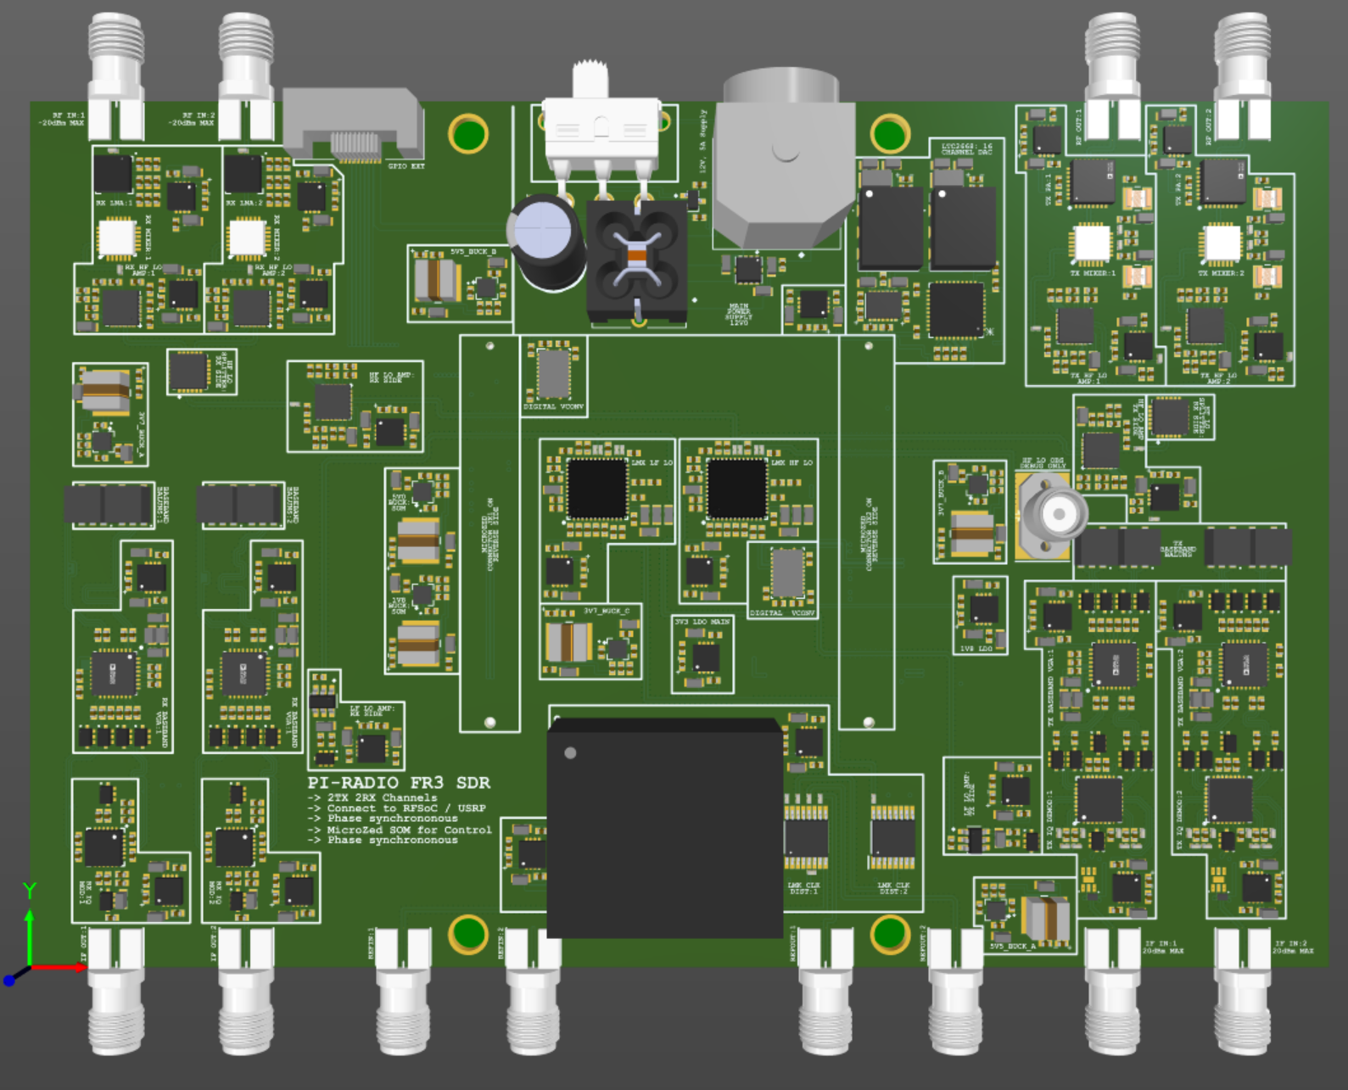
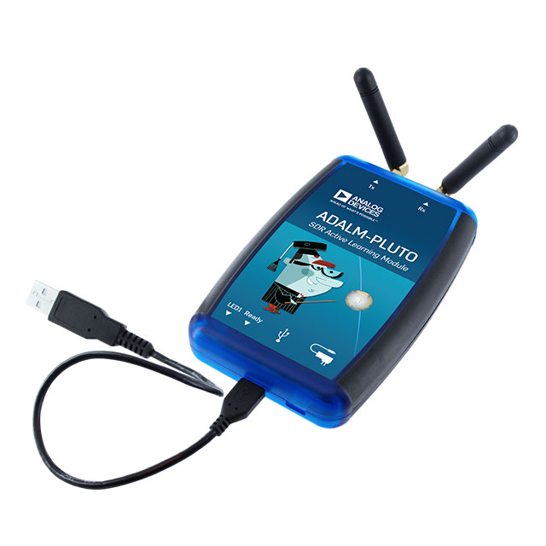
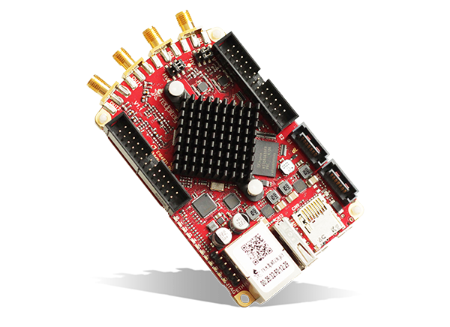
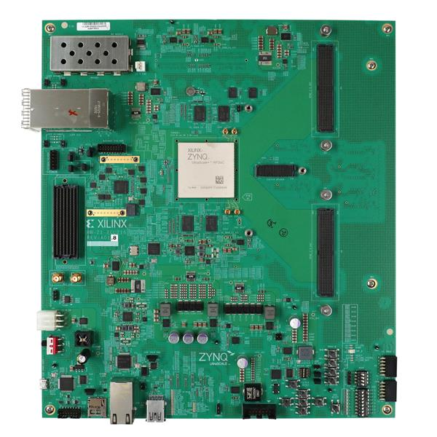
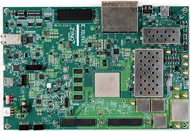
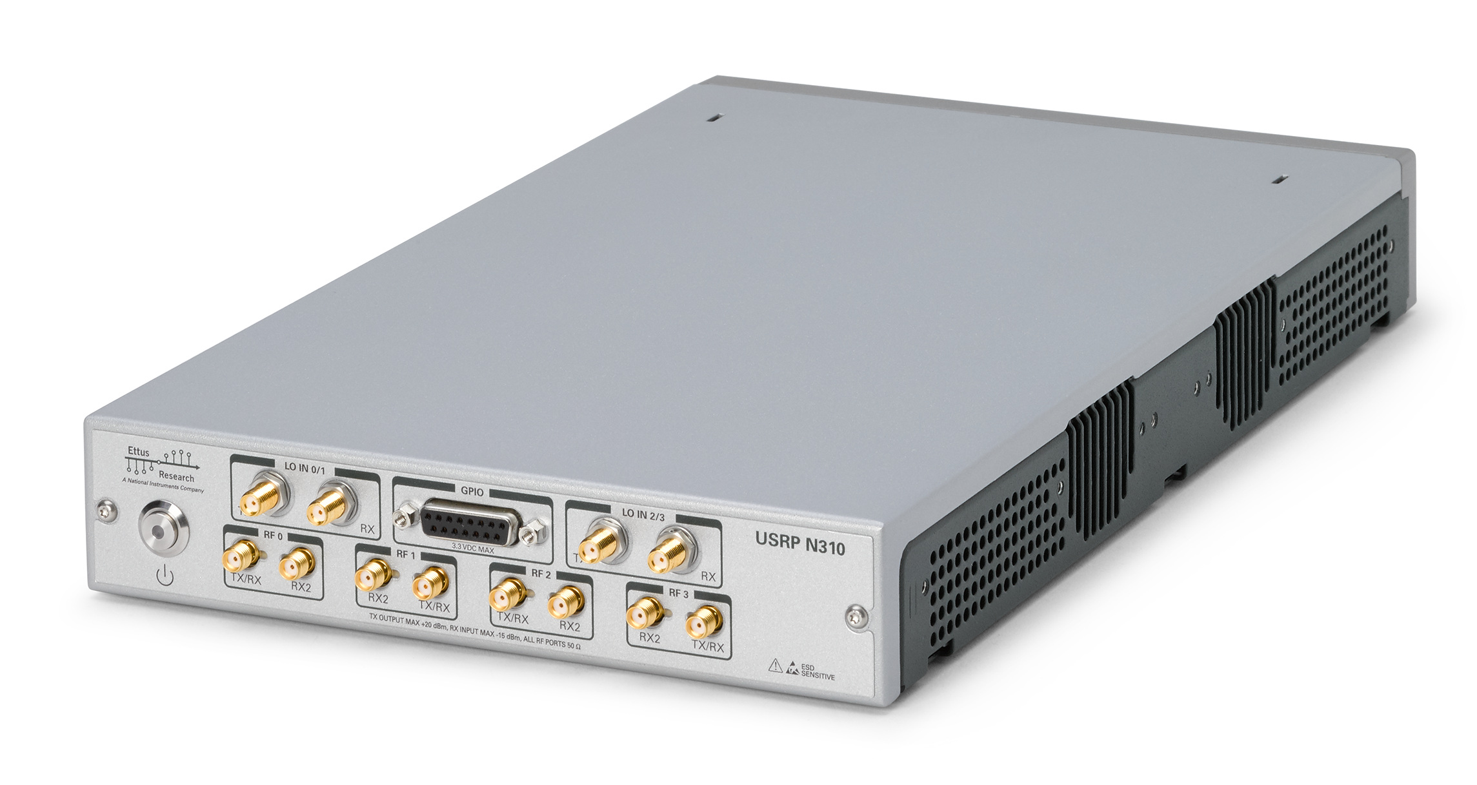
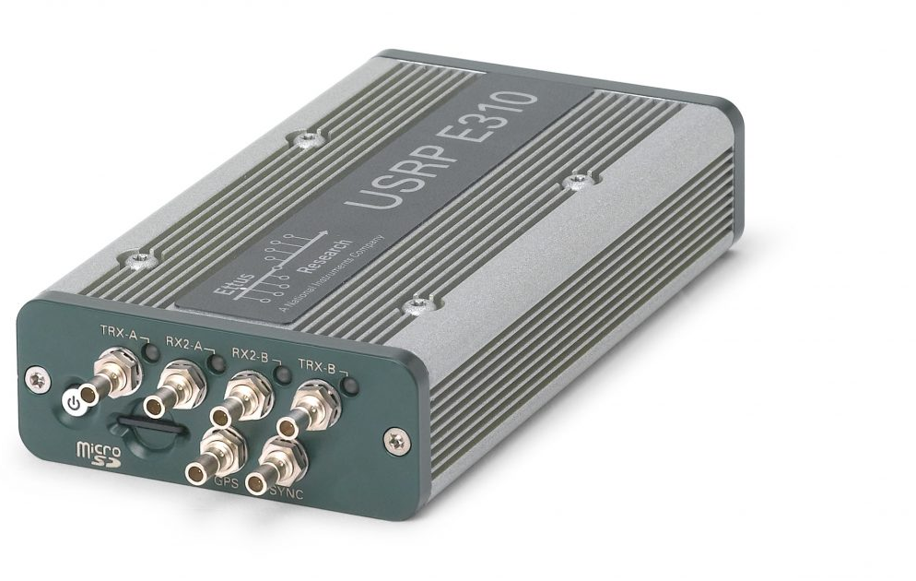
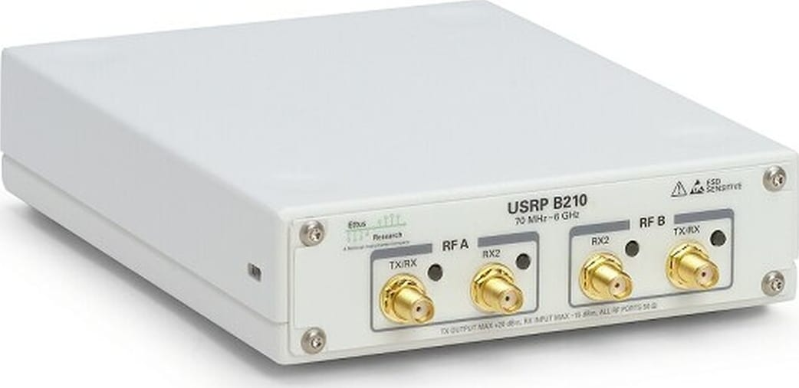
Pi-Radio 2-channel FR3 SDR Front-end Kit
Antenna Board
Transceiver Board
Start using your favorite software tools & workflows with FR3 (6-24 GHz)
Simple interface (SMA cables)
*All logos and images belong to the copyright holders
Plug to any existing
sub-6 GHz SDR
(Ex: USRP, RFSoC, Pluto, etc)

Slide 3
Data Plane: Analog Signal Processing
Front-face of the Pi-Radio FR3 Transceiver Board
RX Side: 2-channel FR3 RF
Input (from antenna board)
TX Side: 2-channel FR3 RF
Output (to antenna board)
RX Side: 2-channel low-noise amplification (LNA) +
down-conversion to baseband
TX Side: 2-channel baseband to FR3 RF up-conversion + power amplification (PA)
RX Side: 2-channel programmable baseband amplification +
filtering + up-conversion to IF
TX Side: 2-channel IF to baseband down-conversion + filtering + programmable amplification
RX Side: 2-channel IF
Output (to USRP/RFSoC)
TX Side: 2-channel IF
Input (from USRP/RFSoC)
Two-stage up- and down-conversion is used to meet the out-of-band (OOB) and adjacent channel rejection ratio (ACLR) requirements and strict spectral masks.

Slide 4
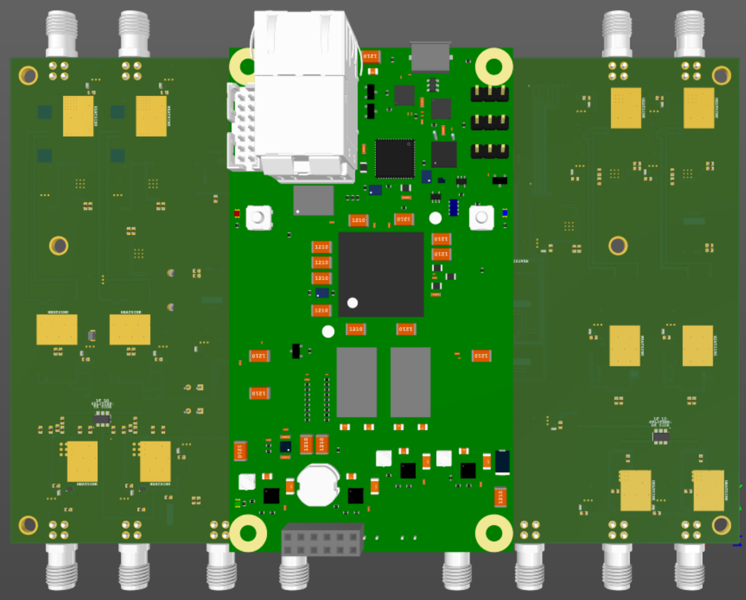
Control Plane: Configure Frequency, Gain, Filters, etc.
Back-face of the Pi-Radio Transceiver Board
Ethernet Port
The Pi-Radio Antenna Board has a Micro-Zed mounted on its bottom-side
Micro-Zed runs Linux. It acts as an SPI/GPIO breakout for the Pi-Radio Transceiver Board for Control
Micro-Zed can either run in stand-alone mode or be connected to a host computer for Control (ex: configure RF frequency, filter banks, various gain levels, clocking tree, etc.)
Micro-Zed can optionally run PTP for fine-grained control of time-gated control operations
Micro-Zed System on Module (SOM)
Controlling the Transceiver Board is very simple, thanks to the Micro-Zed SOM and its built-in Ethernet port.

Slide 5
Clocking/LO Subsystem: Larger channel counts
The local oscillator (LO) subsystem for the IF and RF sub-systems
Onboard 10 MHz OCXO (0.2ppb ultra-high stability) clock
Optional: Two 10 MHz reference inputs to drive the IF and RF LO subsystems
Optional: Two 10 MHz reference outputs to synchronize across multiple devices
The LO subsystem (IF and RF) is synchronized to a 10 MHz reference clock. This 10 MHz clock can be on-board or externally sourced. Multiple devices can share the same reference, to realize larger channel counts.

Slide 6
Preliminary Specifications
Parameter | Value
Number of Channels | 2 transmit, 2 receive
Simultaneous TX/RX | Yes
Bandwidth (Pi-Radio Transceiver Board) | 1 GHz
Usable Bandwidth | Limited by the bandwidth of the USRP / RFSoC
RF Center Frequency Range | 6 – 24 GHz
TX P1dB per channel | 16dBm
RX Noise Figure | 4dB
Baseband filter banks | Programmable with bypass
Baseband gain control | Programmable (60dB gain control range)
Antenna Unit-cell Realized Gain | > 5dBi across the entire range
Local oscillators (LO) for all TX and RX chains | Frequency and phase locked
Clock References | Supports On-board and external clocks
Up-/Down-conversion architecture | Two-stage, for ACLR and OOB requirements
Pi-Radio FR3 Kit Includes | Transceiver board (including Micro-Zed) and Antenna Board
Mechanical | Metallic Case (8x4x2.5 inches) and Supports provided
Power Supply | 12V, 3A (provided)
SDR Hardware schematics | Free and Open-source (GitHub)
Contact: Aditya Dhananjay and Michael Zappe (aditya.dhananjay@pi-rad.io, michael.zappe@pi-rad.io)

Slide 7
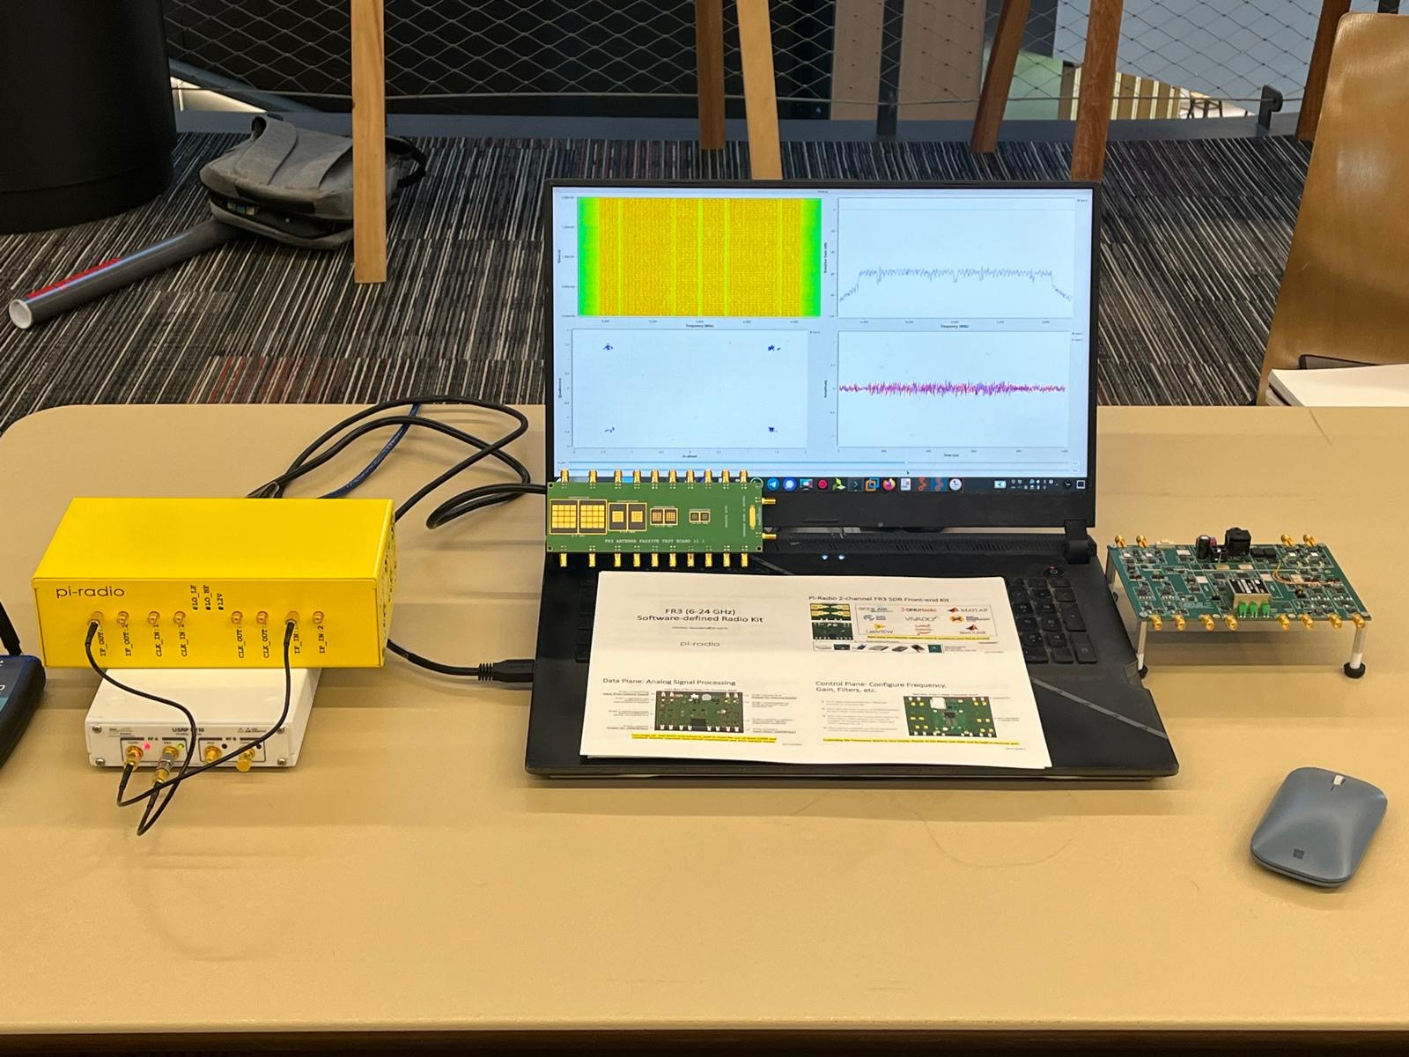
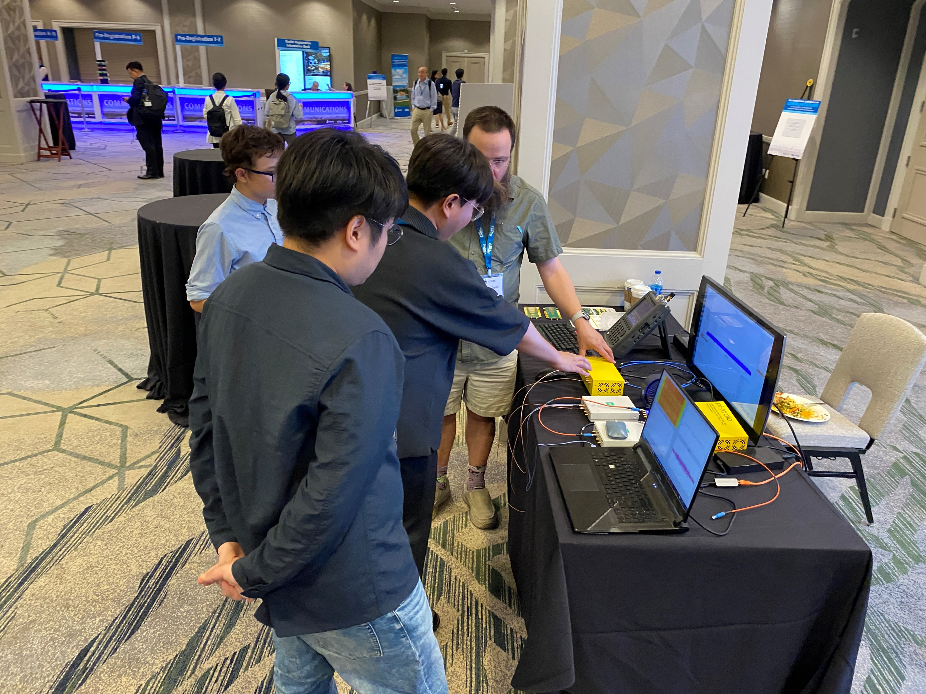
Demonstrations at Conferences (Pre-production hardware)
NEWSDR 2024
ICC 2024

